Slide 1
CAPSTONE PROJECT EXECUTION & REPORT WRITING TOPIC:- SMART DOOR LOCK SYSTEM
Submitted by:- Pranjal Bhanushali

Slide 2


CONTENTS
INTRODUCTION
COMPONENTS REQUIRED
BLOCK DIAGRAM
CIRCUIT DIAGRAM
WORKING
ADVANTAGES
DISADVANTAGES
FUTURE SCOPE
REFERENCES

Slide 3
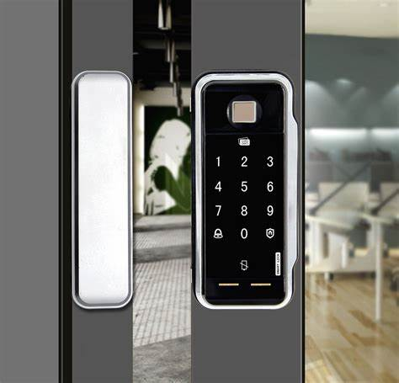
INTRODUCTION
The main aim for providing locks for our home, school, office etc is for security of our lives and property. With the advancement of technology and increase the use of IOT automatic door lock system has become a standard feature on many different types of buildings and homes. And they are become popular every day to develop electronic devices which provide security. Home security has been a major issue because of the increase crime rate and everyday wants to take proper action to prevent unauthorized user so we propose an OTP based smart wireless lock system to enhance the security of digital “door-locks."

Slide 4

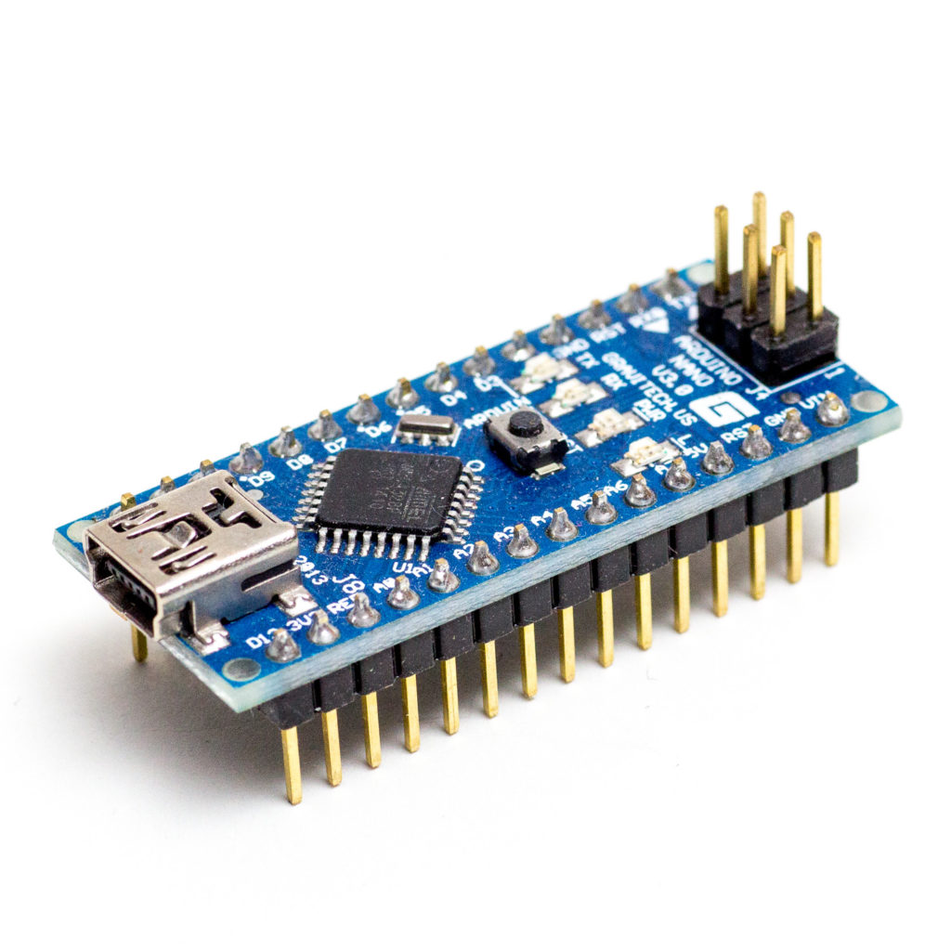
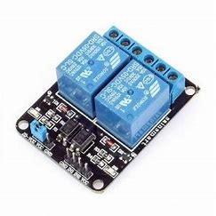

COMPONENTS REQUIRED
ARDUINO Nano
20*4 LCD
Relay
ESP8266 Wi-Fi module
Solenoid Lock
Buzzer
Vibration Sensor
Voltage Convertor
Keypad Matrix
Adaptor

Slide 5
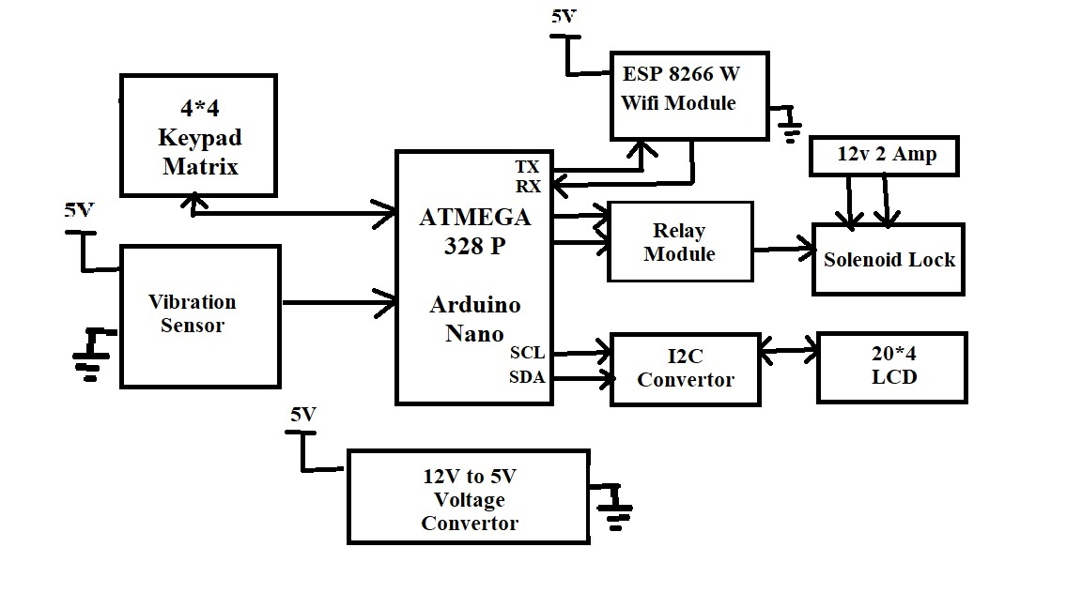
Block Diagram

Slide 6
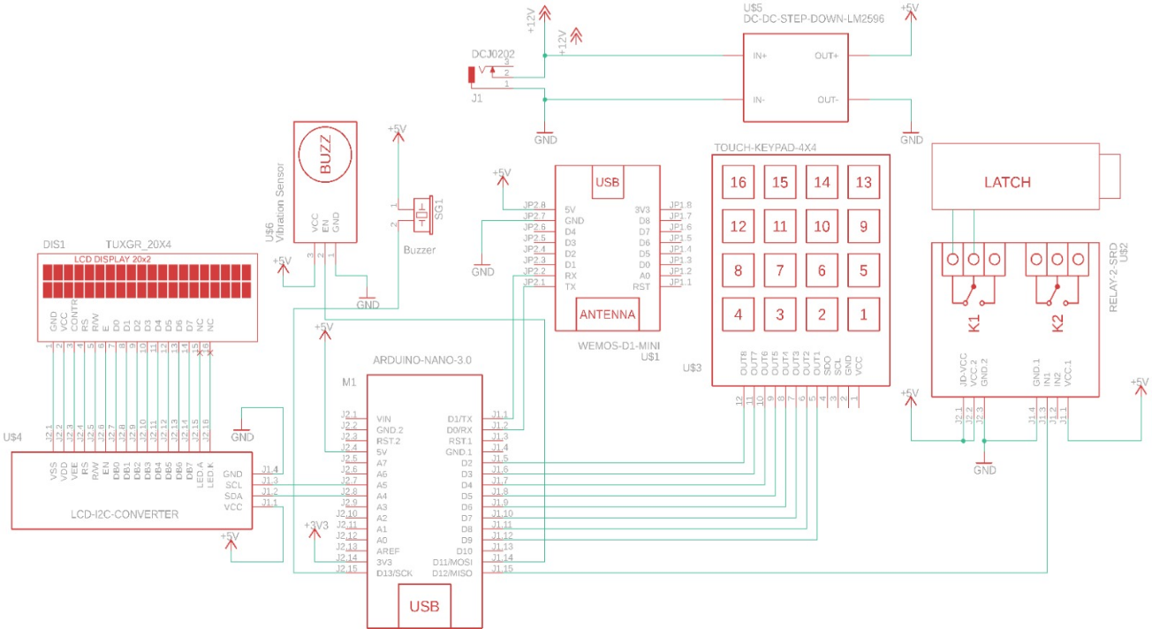
CIRCUIT DIAGRAM

Slide 7
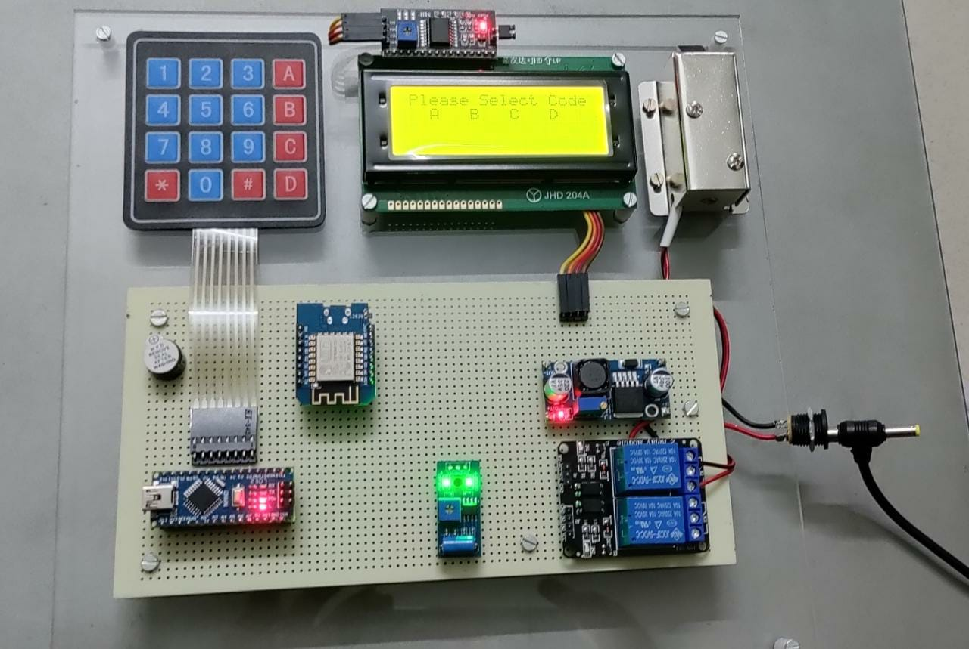
WORKING
When power supply turns on the project starts and it will ask to select your account out of A,B,C,D. When the user selects him/her account out of A,B,C,D then the Arduino nano will select the Telegram ID which was written in the code for respective account A,B,C,D. After this the Arduino nano will generate the package of OTP and Telegram ID and it sends this package to ESP8266w. As ESP8266W module is connected to the Wi-Fi it will send that OTP on respective Telegram ID and it will communicate with the Arduino that the given OTP has been sent. After this Arduino will wait by showing ‘Enter the OTP’ on LCD. As the Arduino know what has been sent to the Telegram ID so as the user types the OTP the Arduino will compare the typed OTP with OTP that has been sent. If the comparison between OTP is correct then it will open the door lock if the comparison is incorrect then it will not open the lock. As there is one more feature in this and that is Alert Alarm. In this feature if any other person tries to open the door or to break the door lock then the vibration sensor become active. When the sensor become active the Arduino will sent the message of ‘CODERED’ to ESP8266W module and the module will send this message to the user’s Telegram ID.

Slide 8

ADVANTAGES
It has more security.
It does not allow unknown people.
It is also used for anti- thefting strategy.
It reduces the efficiency of the cost.
Simple and easy implementation’s.
It has less power Consumptions.

Slide 9
APPLICATIONS
Control of doors and windows shutters
Faster operation and efficient
Security System
This project can be used in Industries, Home, office and Shops
It can be used for garage doors and gates.
By using smart app, disabled or elderly people can control lock as well as appliances anywhere inside house.

Slide 10
CONCLUSION
The main proposal for this project is to increase the extra security to the people .This project will help in keyless entry and at the same time will be more secure. Thus we can conclude that the aim of this this project to provide security

Slide 11

FUTURE SCOPE
The future scope for this is to extensions within the app cloud also be viewing who is passing through the door by adding the camera and sending stream directly to mobile device. The other extension for this project is to add a camera with built-in SD card and also the finger print sensor

Slide 12

References
https://www.elprocus.com/buzzer-working-applications/
https://www.instructables.com/I2C-LCD-Adapter/
https://components101.com/sensors/sw-420-vibration-sensor module#:~:text=The%20vibration%20sensor%20module%20based,the%20sensor%20provides%20Logic%20High

Slide 13


